Slide 1

MAPPING LAND COVER AND LAND USE CHANGES IN LAIKIPIA County
PROJECT BY; MICHAEL SIRYA MWARUAH
REG NO: F19/1929/2014

Slide 2
CHAPTER 1: INTRODUCTION
1.1 Background to the problem
Land use and land cover change is gaining recognition as a key driver of environmental change (Riebsame et al., 1994).
Interest on land use change has a long history as there have been no instances in which people use land and its resources without causing harm.

Slide 3
1.2 Problem Statement
As human populations increase, the expansion of settlement and extraction of resources put pressures on ecosystems and wildlife populations.
Numerous studies have demonstrated that substantial changes in hydrological regimes can arise due to land cover changes especially the decline in forests due to their influence on rainfall interception, evapotranspiration, infiltration and surface runoff

Slide 4
Main Objective
To produce a land cover land use map of Laikipia County at different epochs in order to detect and monitor the changes that have taken place and subsequently quantify the changes that have occurred over a period of time.

Slide 5
Specific objectives
Determine trend, nature, location and magnitude of land use and land cover change in Laikipia County.
Analyze and depict land use and land cover change in the Laikipia county.

Slide 6
Scope of the study
The parameters investigated in the study are land use and land cover change, with time within Laikipia County.

Slide 7
1.7 Limitations of the study
A portion of the 1989 images of the North West region of the study area was not available and therefore a 1988 image was used for only that specific portion of the 1989 image thus causing some unavoidable errors.
These images were taken using different sensors and therefore had different spectral resolution which introduces an error during image classification. In addition, the classification was based on the spectral response of the land cover type.
.

Slide 8
Limitations of the study
However, some land cover may give the same reflectance; for example, farms that have been cultivated but not planted may reflect the same way as bare ground. Seasonal variations have an influence on vegetation. However, all the months when the images were taken were generally dry.
Atmospheric interference , in this case cloud cover, obscured some portions of the 2009 and 2018 images causing problems in the image classification.
Collection of ground truth data was limited to the availability of resources and Google Earth was used for the ground-truthing.
Incompatibility of the various GIS software's made the study a cumbersome process.

Slide 9
CHAPTER 2
LITERATURE REVIEW
Land use land cover change refers to transformation of the surface of the earth by natural and human factors. This is a process that involves identifying driving factors to change and analyzing them, monitoring land resources to identify changes and carrying out predictions (Carmelita et al., 2002.)

Slide 10
2.3 Significance of land use land cover CHANGE MAPPING
Establishes a baseline for land cover change detection
Plays a critical role in planning and management of the existing natural resources to ensure sustainable development.
Provides knowledge that forms the basis of studies on removal of disturbances on productive land, urban encroachment and depletion of forest (Kavitha et al., 2012).

Slide 11
2.4 Land Use and Land Cover Change
Land use land cover change is one of the main driving forces of the unprecedented changes in environmental processes and the ecosystem that have been experienced in the recent past all around the world.
To ensure sustainable development, the study , analysis and mapping of land cover land use changes at a global scale has become a necessity in order to inform decision making in environmental planning and ecological management.(Kalantari et al ., 2014).

Slide 12
CHAPTER 3: METHODS AND MATERIALS
Description of the Study Area
Laikipia County is a vast plateau to the north-west of snow-capped Mount Kenya, straddling the equator at the heart of the Kenyan Rift Valley Region. It spans an area of over 9500 square kilometers.
The plateau extends from the foothills of Mount Kenya to the wall of the Rift Valley at Lake Baringo and stretches northwards towards Samburu land. These plains are physically diverse and scenically spectacular, covered by open grasslands, basalt hills, lonely kopjes and dense cedar forests, fed by the Ewaso Nyiro and Ewaso Narok rivers.
Laikipia is the 15th largest county in Kenya based on land size. It borders seven counties namely : Samburu to the North; Isiolo to the North East ; Meru to the East ; Nyeri to the South East ; Nyandarua and Nakuru to the South West; and Baringo to the West.

Slide 13
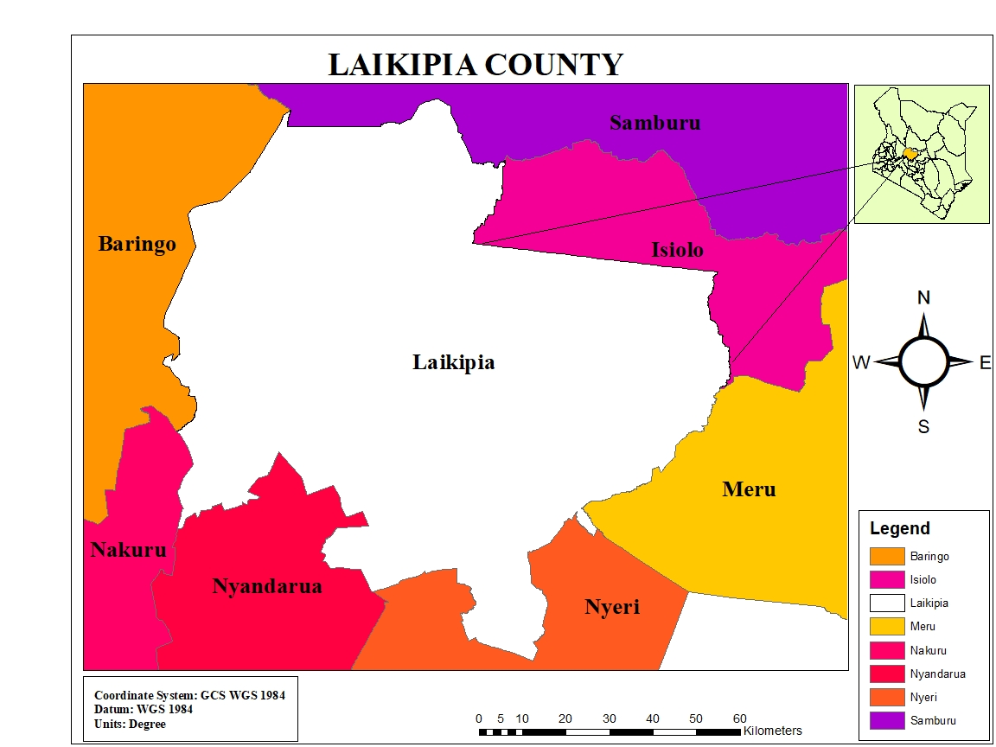

Slide 14
Data Sources
Considering good spectral, temporal resolution and moderate spatial resolution Landsat images were acquired (Lillesand et al., 2004). Four multispectral images for different epochs of 1989, 2000, 2009 and 2018 were acquired from the regional center for mapping and resource development (RCMRD).
ARC GIS was used for layer stacking, sub setting, image classification, recording of features, accuracy assessments, re-projection and analysis

Slide 15
Summary of Methodology
Data Acquisition
Pre processing and Image Classification
GIS Overlay
Accuracy Assessment
Analysis
Results and Discussion

Slide 16
CHAPTER FOUR: RESULTS AND DISCUSSIONS
Land Use Land Cover Map in Laikipia County
From the Landsat images and ground truth data used, the following were the classes of land use and land cover; Natural forest, Farms, Wetlands, Grasslands, Bare lands and Settlements.
However due to evident cloud cover in the 2009 and 2018 Land sat images a seventh class called Cloud/No data was included as a solution to cater for the effects of the cloud cover on the mapping exercise.
In this context Natural forest includes multilayered vegetation unit dominated by trees.
Farms stood for Irrigated and rain fed arable land, crop land, farming and fallow fields.

Slide 17
Land Use Land Cover Map in Laikipia County
Grasslands included lands dominated by grasses rather than large shrubs or trees.
Bare lands included Land without natural, conventional or usual covering.
Settlements included built up areas, residential, commercial, industrial, institutional, recreational areas and road networks.
Wetlands included rivers, dams, swamps and lakes.
Cloud/No data included a fraction of the image obscured by clouds. The observed distribution of land use land cover in Laikipia County is as represented in the table below.

Slide 18
 | 1989 |  | 2000 |  | 2009 |  | 2018
 | Area (Ha) | Area% | Area (Ha) | Area% | Area (Ha) | Area% | Area (Ha) | Area%
Natural Forest | 41666.71776 | 4.353633615 | 70828.3691 | 7.421566303 | 12855.4601 | 1.347019 | 21151.60176 | 2.21631
Wetlands | 1201.199724 | 0.12550985 | 537.611316 | 0.056332202 | 236.403187 | 0.024771 | 369.807886 | 0.038749
Settlements | 63825.03902 | 6.66889187 | 63138.75885 | 6.615830508 | 112412.8464 | 11.77883 | 215143.2076 | 22.54317
Farms | 179863.6731 | 18.79342976 | 34230.54712 | 3.586758785 | 88579.67822 | 9.281544 | 130833.2976 | 13.70899
Bare land | 359884.2579 | 37.60325475 | 540407.1504 | 56.62515668 | 310226.7868 | 32.50614 | 371362.9632 | 38.91221
Grasslands | 310615.2511 | 32.45528016 | 245216.336 | 25.69435552 | 361521.3048 | 37.88088 | 165620.6516 | 17.35409
Cloud/No data | 0 | 0 | 0 | 0 | 68531.13424 | 7.18082 | 49879.60302 | 5.226491
Total | 957056.1386 | 100 | 954358.7728 | 100 | 954363.6137 | 100 | 954361.1326 | 100

Slide 19
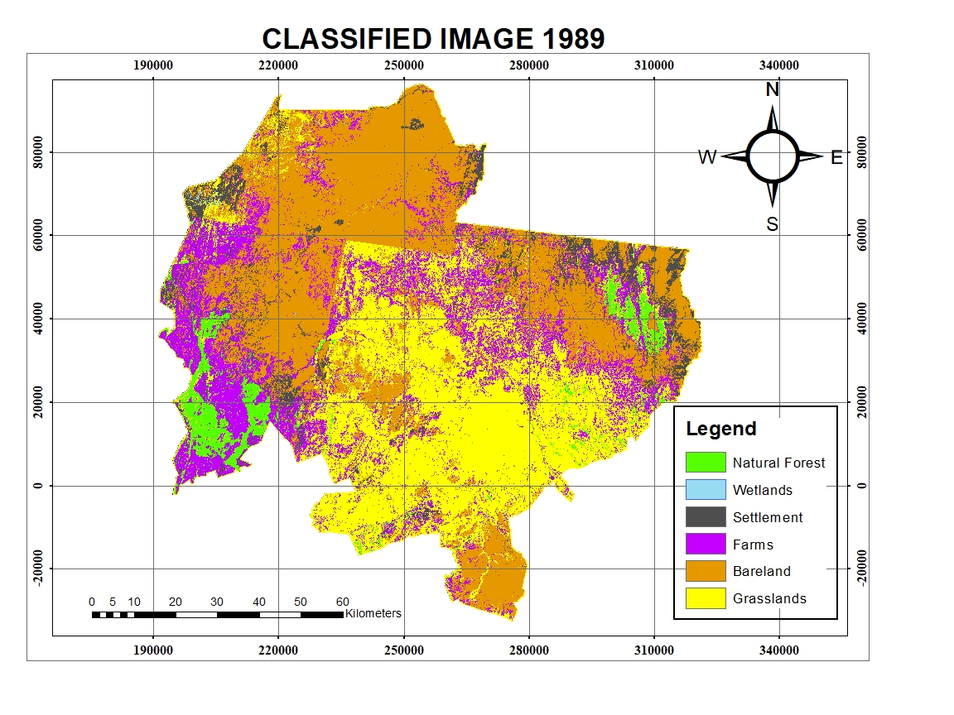
Land Use and Cover Distribution in 1989

Slide 20
Graphical presentation of Land use land cover distribution in 1989

Slide 21
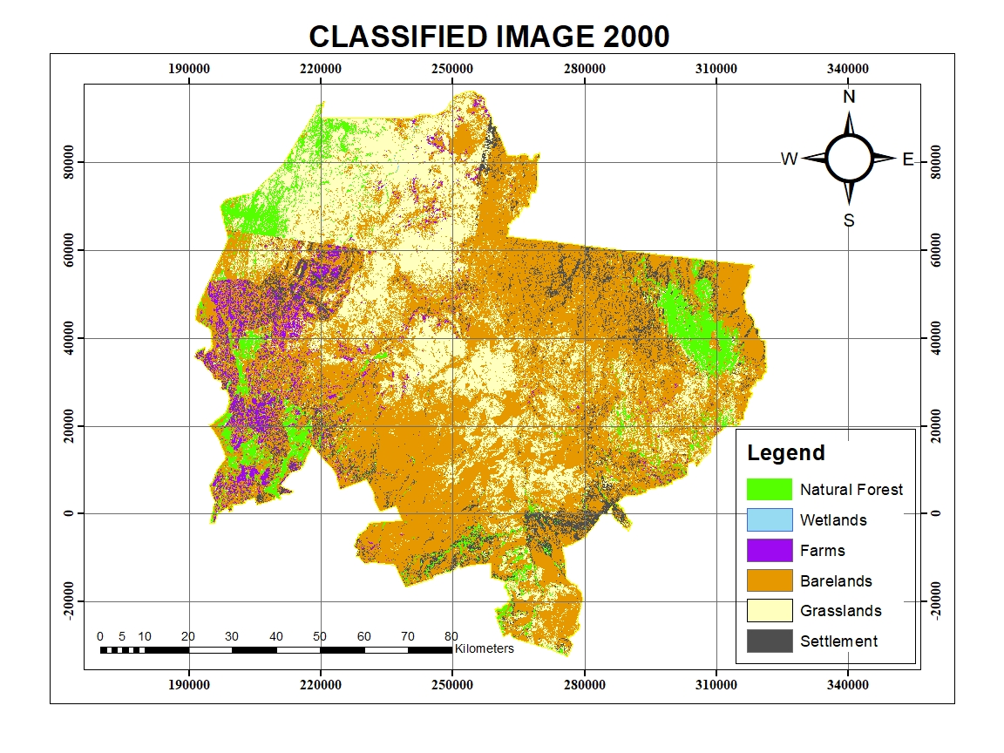
Land use land cover distribution in 2000

Slide 22
Graphical presentation of Land use land cover distribution in 2000

Slide 23
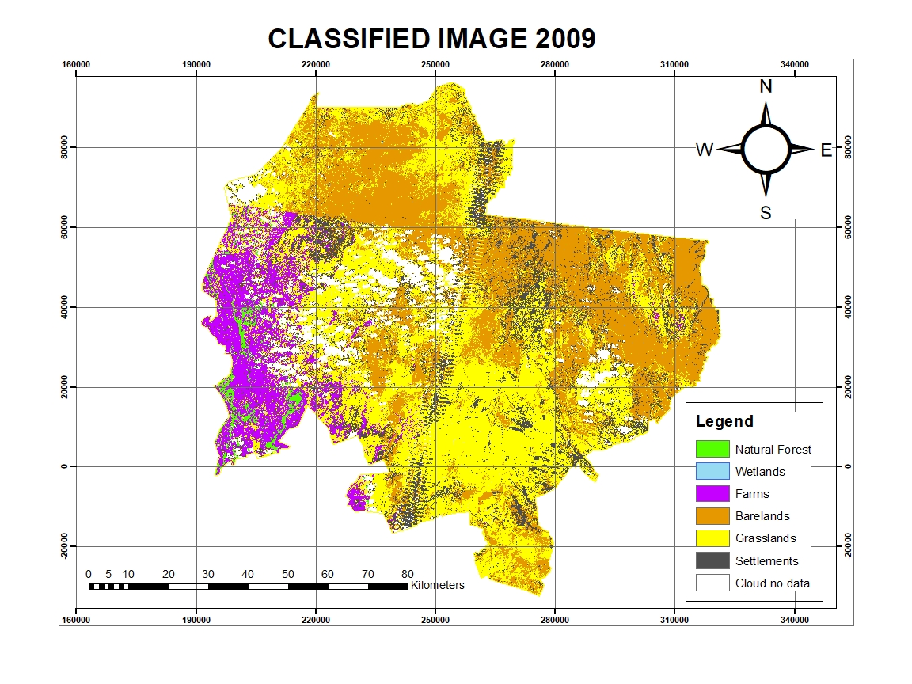
Land use land cover distribution in 2009

Slide 24
Graphical presentation of Land use land cover distribution in 2009

Slide 25
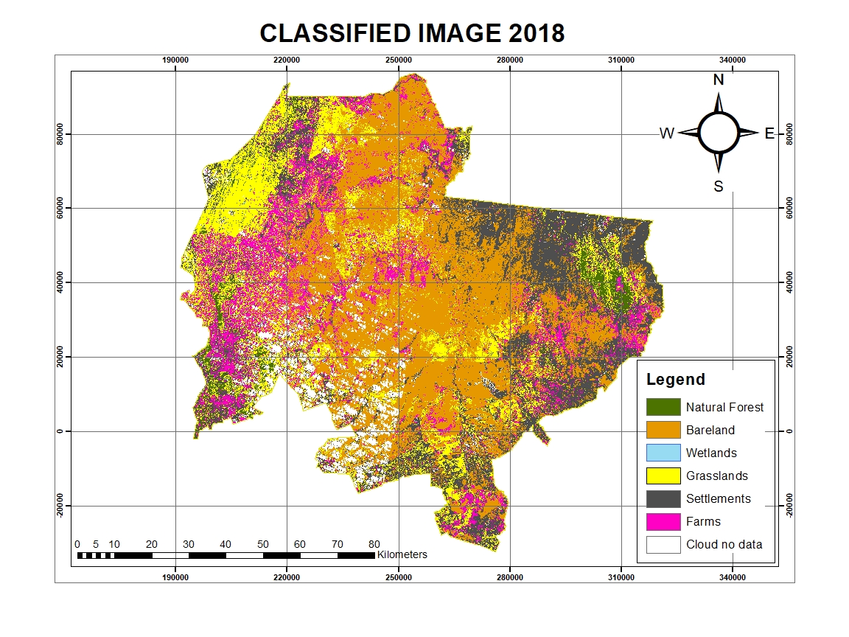
Land use land cover distribution in 2018

Slide 26
Graphical presentation of Land use land cover distribution in 2018

Slide 27
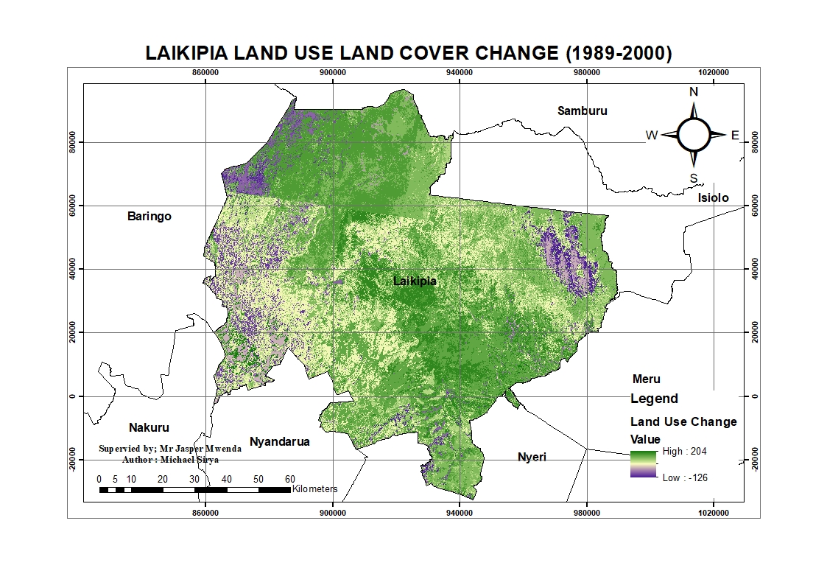
Land use change between 1989 and 2000

Slide 28
Graphical presentation of land cover change between the years 1989-2000

Slide 29
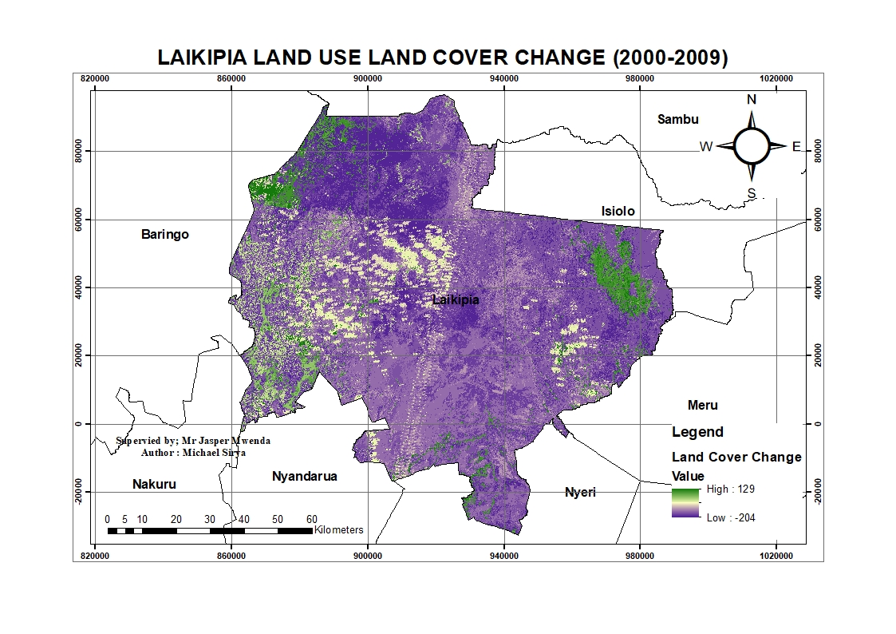
Land use land cover change between 2000 and 2009

Slide 30
Graphical presentation OF land cover change between 2000 and 2009

Slide 31
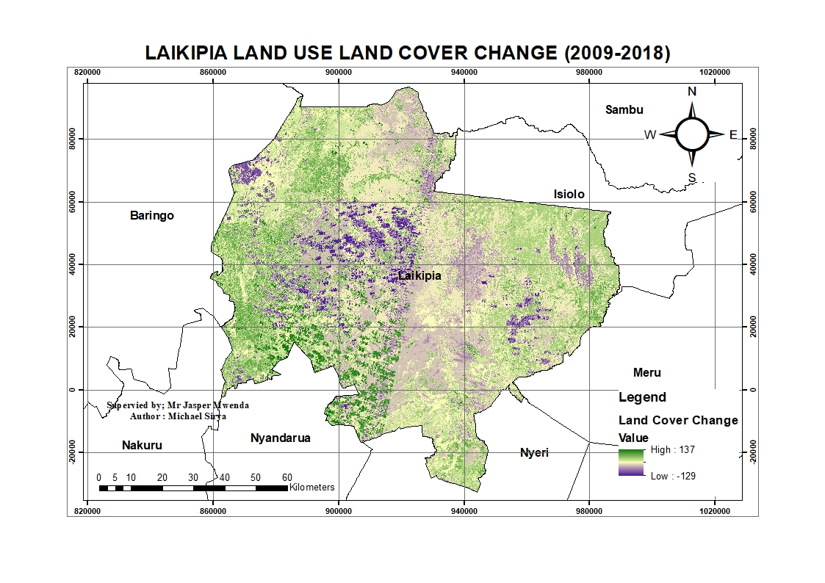
land cover change between 2009 and 2018

Slide 32
Graphical presentation of Land Cover change 2009-2018

Slide 33
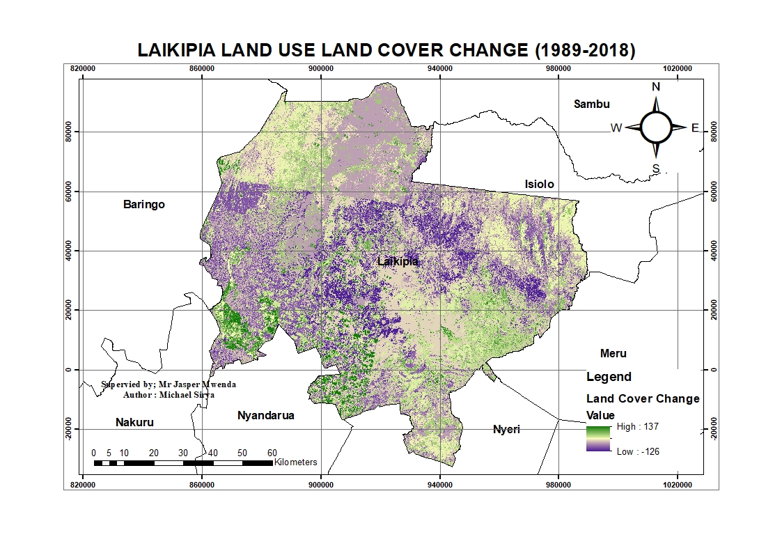
Land Cover change between the years 1989-2018

Slide 34
Graphical presentation of land cover changes between 1989 and 2018

Slide 35
Trends in Land Cover Land Use

Slide 36
Trends in Land Cover Land Use

Slide 37
Trends in Land Cover Land Use

Slide 38
Trends in Land Cover Land Use

Slide 39
Trends in Land Cover Land Use

Slide 40
Trends in Land Cover Land Use

Slide 41
Conclusion
In general the study points out that there is decrease in forest cover , wetlands and grasslands . The land has become Bare and farming has been affected . However with growth of human population the built have areas have greatly increased

Slide 42
Recommendations
Establish a GIS and Remote Sensing Department
Regularly updating and Creation of Land Use plans
Increase conservation measures
Improve security

